Slide 1


Linking survey and web tracking data
Digisurvor workshop - Manchester
Toby Crisp
14 February 2025
© Ipsos | Ipsos_Linking_survey_web_tracking_data | Feb 2025 | Version 1 | Public | Strictly Confidential

Slide 2
Contents
1
2
3
Ipsos and my role
iris
The panel
4
5
6
Surveying panellists
Costs
Success stories to date

Slide 3
Contents
1
2
3
Ipsos and my role
iris
The panel
4
5
6
Surveying panellists
Costs
Success stories to date

Slide 4






Ipsos iris is the only industry endorsed solution for online audience measurement in the UK
INDUSTRY BODIES FOR AUDIENCE MEASUREMENT
PAMCo
RAJAR
Barb
ROUTE
Others

Slide 5





Key
pillars
Establishment Survey
(Census data for national representation and panel accuracy)
10,000 single source mobile first multi device panel
(Provides demographics and behaviour data as well as non-tagged traffic)
DATA SCIENCE bring all of this together
Measurement of small sites
Site centric measurement
(Accurate actual traffic and device measurement)
endorsed by UKOM

Slide 6
Contents
1
2
3
Ipsos and my role
iris
The panel
4
5
6
Surveying panellists
Costs
Success stories to date

Slide 7
The panel
It is the key source of information on people’s behaviour which is linked to devices
Passively metered behaviour of the 10,000 single-source (with c.25,000 devices) panel
The panel is representative of the UK adult internet-using population (aged 15+, recruited to quotas set from the Establishment Survey):
TV region
Age group by gender
Social grade
Life stage and household size
Device types used
Internet usage (weight of)

Slide 8
Recruitment
A variety of both online and offline recruitment methods are used to recruit the sample, including other Ipsos recruited eligible passive panels
29% of the current sample have been recruited from an offline source, either postal invite or telephone
Each panellist is asked to register all the devices they use to access the internet, but are accepted onto the panel without complete coverage of all their devices (e.g. both home and work) provided that they register at least their primary personal device and one other personal device

Slide 9
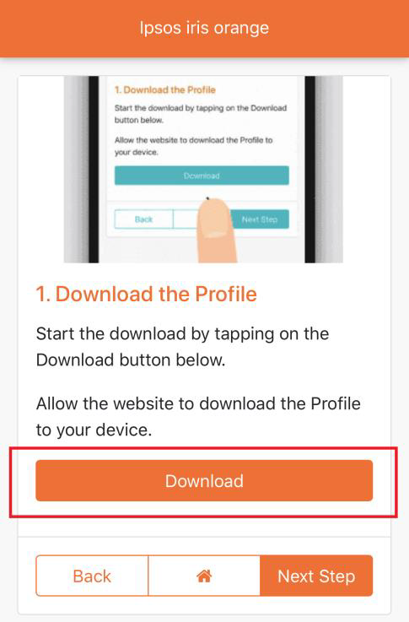
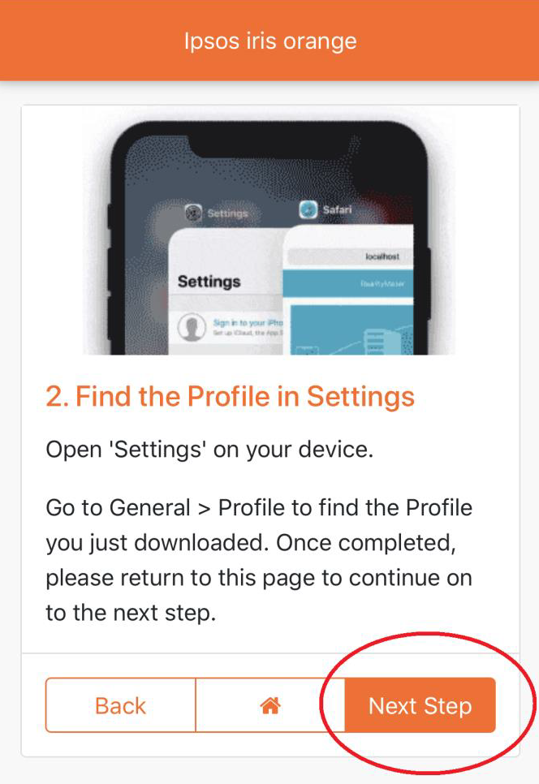
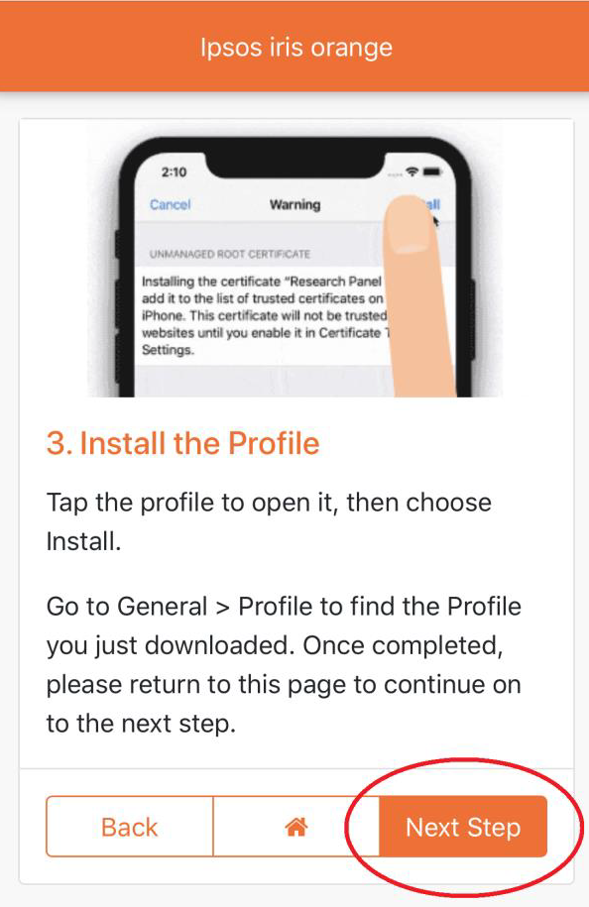
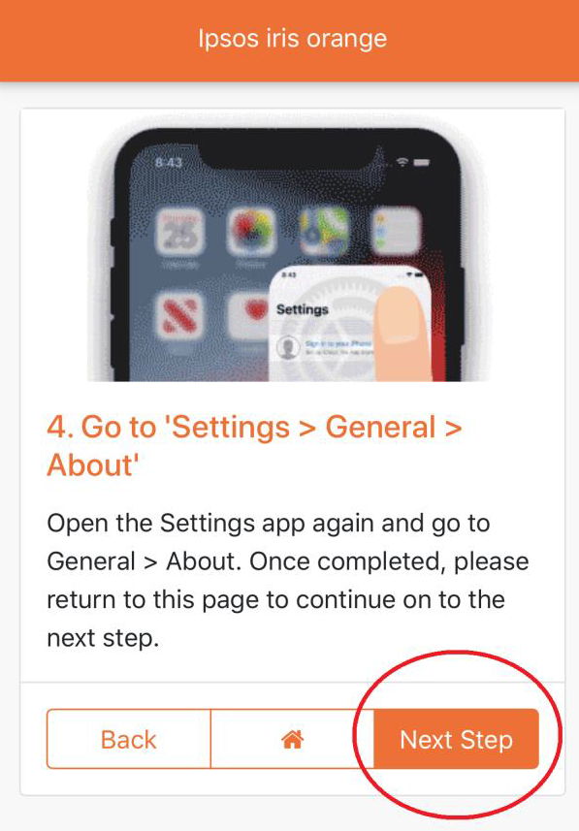
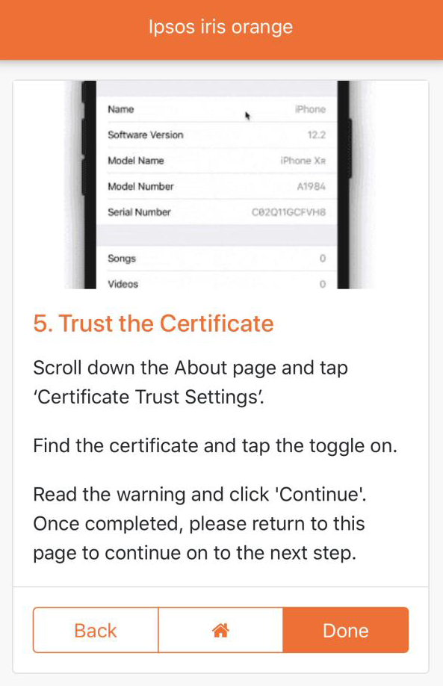
Process

Slide 10
Management
Computers (PCs, Macs, laptops), smartphones (Android, iOS) and tablets (Android, iOS) are all measured and can be reported individually and cross-platform to provide unduplicated audience estimates
The panel needs careful and proactive management. Panellists regularly upgrade their devices or delete software either intentionally or by mistake, and so device usage by panellists is actively monitored on a daily basis to confirm availability and identify, follow-up, understand and confirm periods of inactivity
Additionally, links have been developed between the installed smartphone passive measurement software and the Ipsos panel management system. This allows the direct monitoring of performance on this device. If enabled, interaction with the panellist is also possible via push notifications
Panel members are enrolled into a rewards programme, where based on the number of installed and active devices, they receive a set amount into the form of points. These points can be exchanged for a large variety of products, vouchers, or can be donated to charity

Slide 11
Contents
1
2
3
Ipsos and my role
iris
The panel
4
5
6
Surveying panellists
Costs
Success stories to date

Slide 12
Surveying panellists
For a subset of the 10,000 panellists (circa 6,000) we have consent to invite them to participate in surveys
Responses incentivised with points
Can typically recruit up to 2,000 respondents per survey
Do not want to influence online behaviour, so will be selective about what we ask
Notes:
One example of influencing behaviour might be asking about a future event, and only giving a limited selection of possible responses – e.g. what gambling company would you use to place a bet on the Cheltenham horse racing festival: a) Bet365, b) PaddyPower, c) Coral? You’re subconsciously influencing future behaviour.

Slide 13
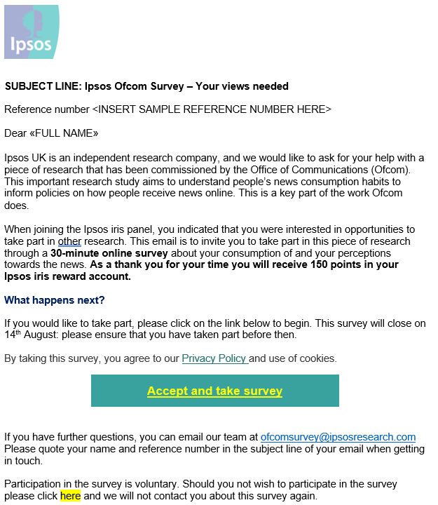
Example invitation

Slide 14
Contents
1
2
3
Ipsos and my role
iris
The panel
4
5
6
Surveying panellists
Costs
Success stories to date

Slide 15
Costs
Incentive costs: £3 per respondent
Fixed scripting/hosting/coding costs: circa £5,000
Survey design/data analysis/delivery: project by project basis

Slide 16
Contents
1
2
3
Ipsos and my role
iris
The panel
4
5
6
Surveying panellists
Costs
Success stories to date

Slide 17
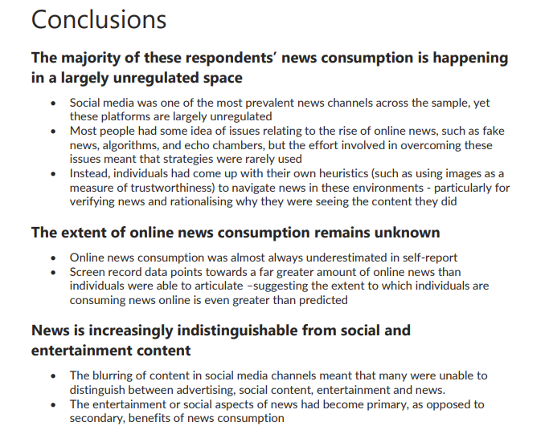
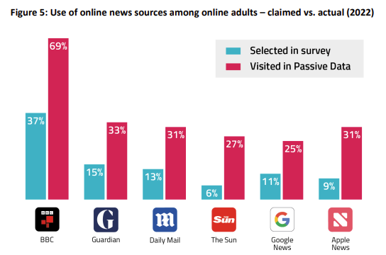
News plurality
Closing the say-do gap

Slide 18
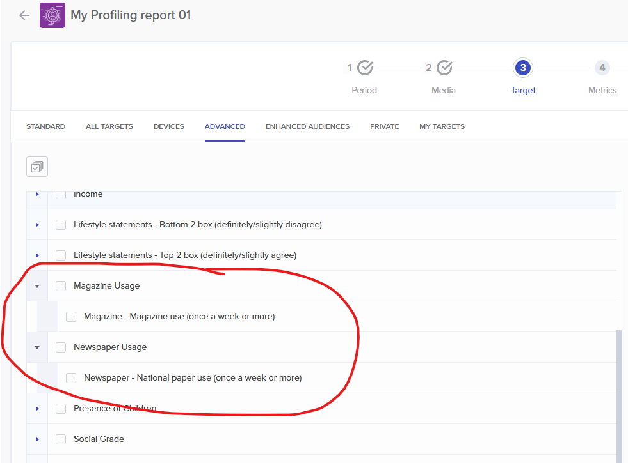
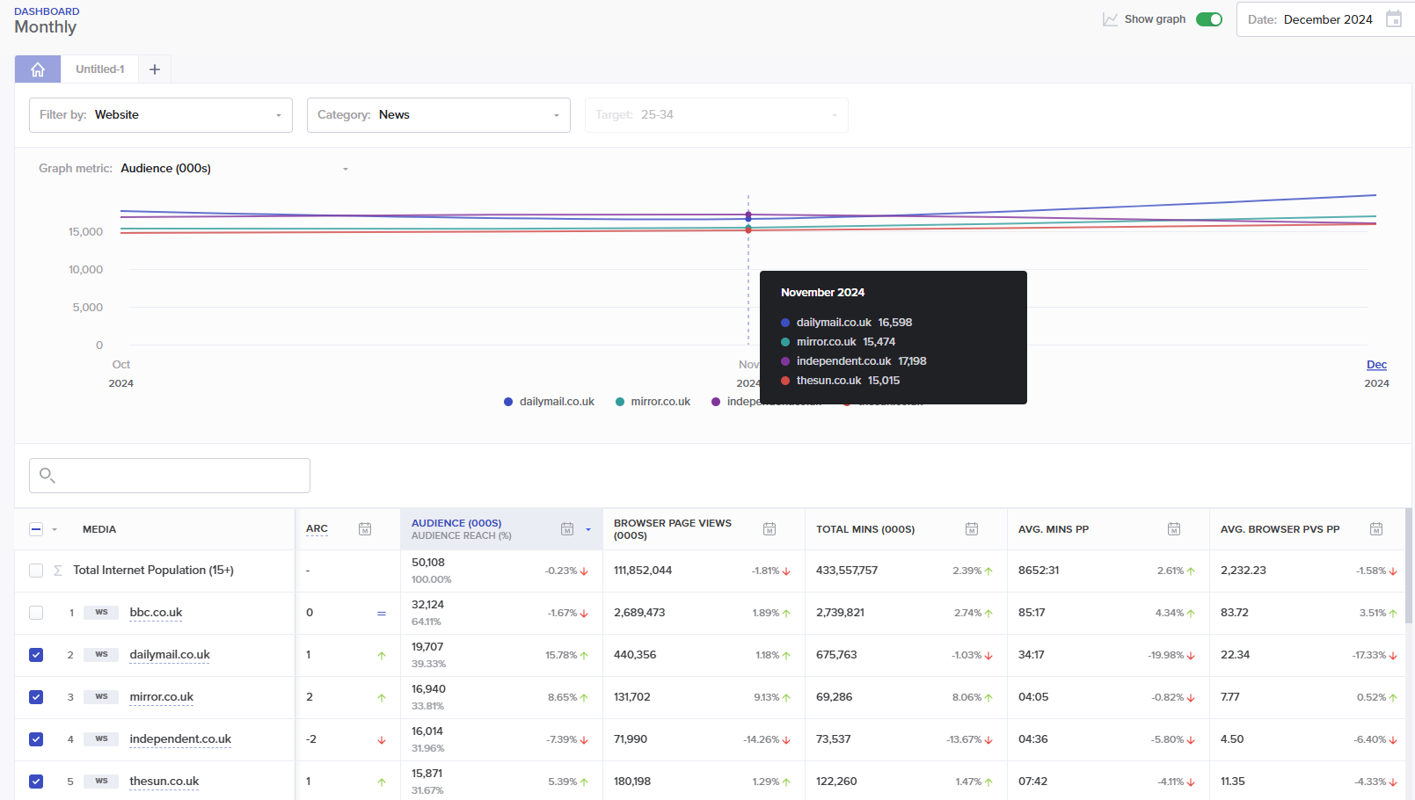
Adding new profiling variables to iris

Slide 19

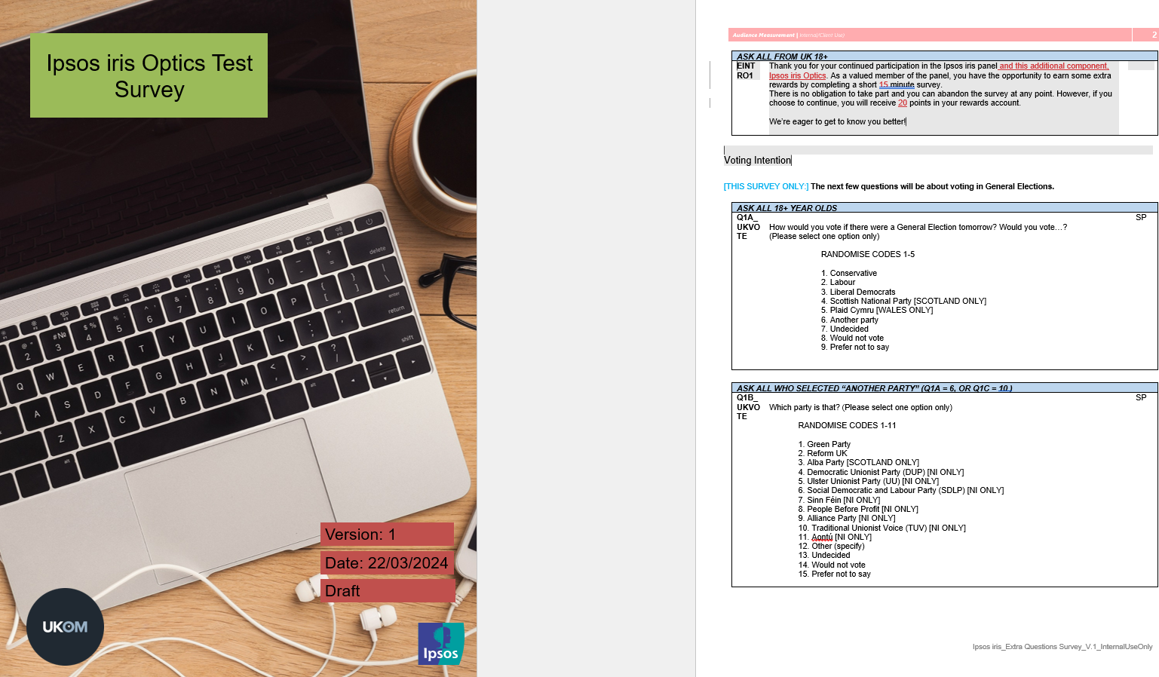
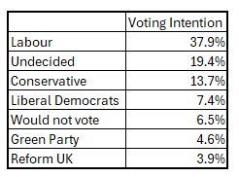
Gauging the nation

Slide 20

THANK YOU
Toby Crisp
Toby.Crisp@ipsos.com

Slide 21
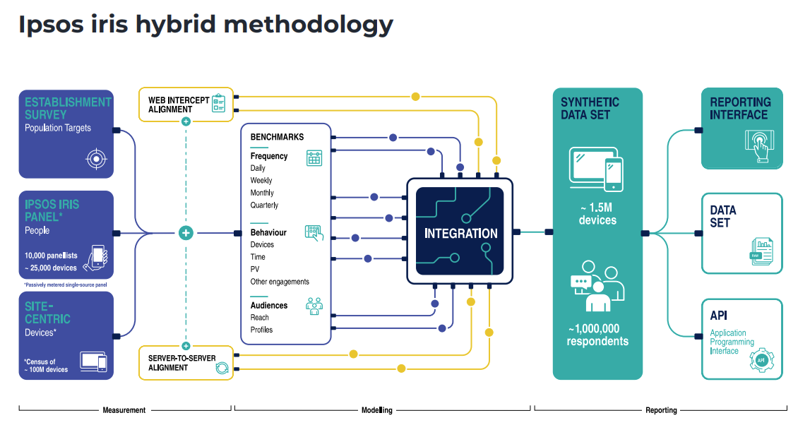
Further information
Integration through synthetic panel (1.5m devices, 1m people)
Ipsos use of synthetic data: SYNTHETIC_DATA_GETS_REAL-Digital_v1.2.pdf

